Slide 1
Introduction to simple linear equations. Systems of Linear equations.
Lesson 1

Slide 2
Systems of Equations
A set of equations is called a system of equations.
The solutions must satisfy each equation in the system.
If all equations in a system are linear, the system is a system of linear equations, or a linear system.

Slide 3
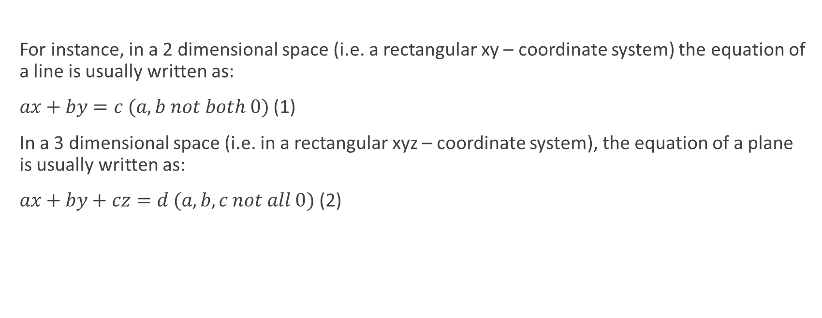
The form of a linear equation depends on the number of dimensions of the space it belongs to.
For instance, in a 2 dimensional space (i.e. a rectangular xy – coordinate system) the equation of a line is usually written as:
$ax+by=c (a,b not both 0)$ (1)
In a 3 dimensional space (i.e. in a rectangular xyz – coordinate system), the equation of a plane is usually written as:
$ax+by+cz=d (a, b, c not all 0)$ (2)

Slide 4

In n- dimensional space…
Generalizing from the above two examples, we can conclude that the general form of a equation in a “n” dimensional space can be written as:
$a_{1}x_{1}+a_{2}x_{2}+…+a_{n}x_{n}=b,$
$where a_{1}, …,a_{n} are coefficients and not all 0$ (3)

Slide 5
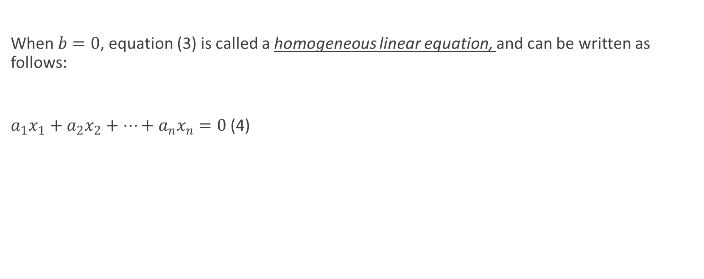
Special case
When $b=0$, equation (3) is called a homogeneous linear equation, and can be written as follows:
$a_{1}x_{1}+a_{2}x_{2}+…+a_{n}x_{n}=0$ (4)

Slide 6
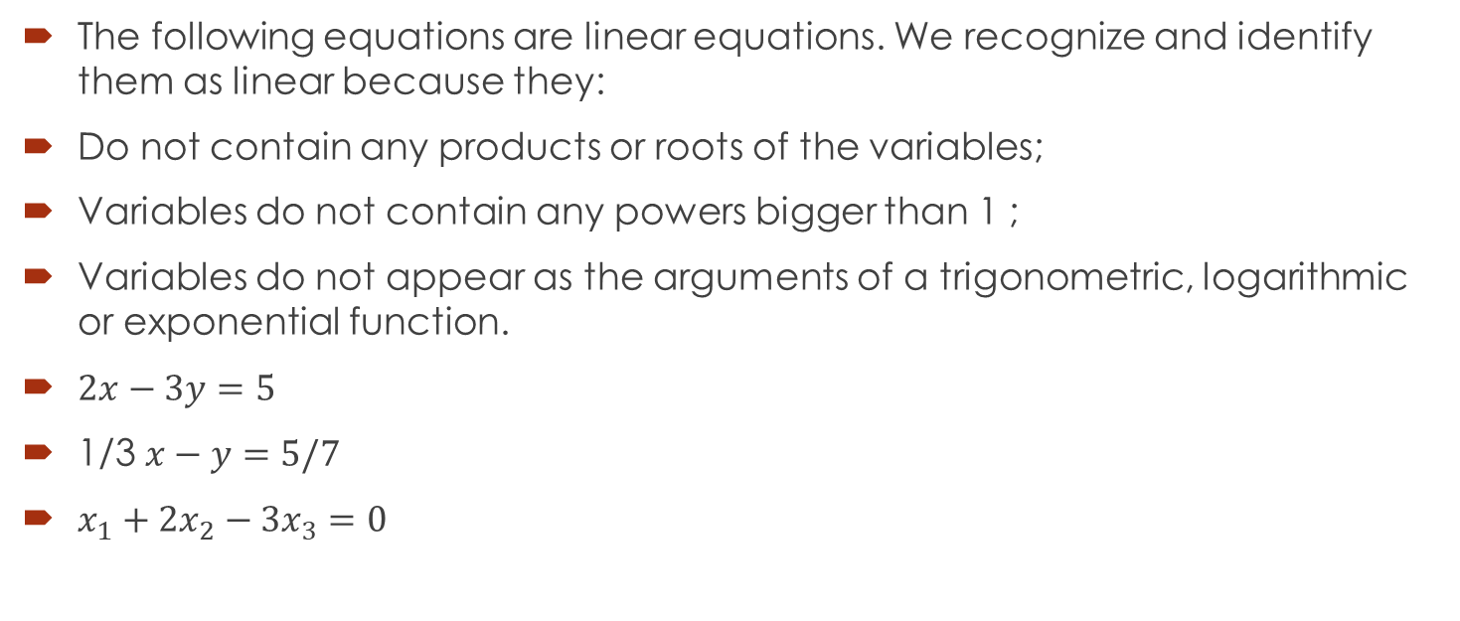
Examples of linear equations
The following equations are linear equations. We recognize and identify them as linear because they:
Do not contain any products or roots of the variables;
Variables do not contain any powers bigger than 1 ;
Variables do not appear as the arguments of a trigonometric, logarithmic or exponential function.
$2x−3y=5$
1/3 $x−y=5/7$
$x_{1}+2x_{2}−3x_{3}=0$

Slide 7
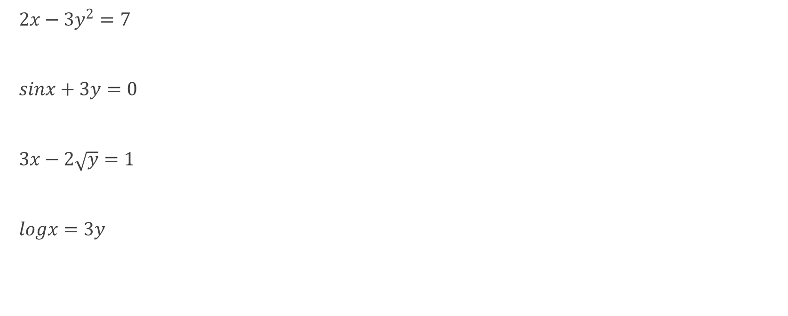
Are these linear equations?
$2x−3y^{2}=7$
$sinx+3y=0$
$3x−2\sqrt{y}=1$
$logx=3y$

Slide 8
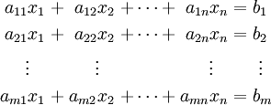
General form of a system of m equations with n variables
A set of linear equations is called a system of linear equations or a linear system.
A general system of m linear equations with n unknowns (or variables) can be written as:

Slide 9
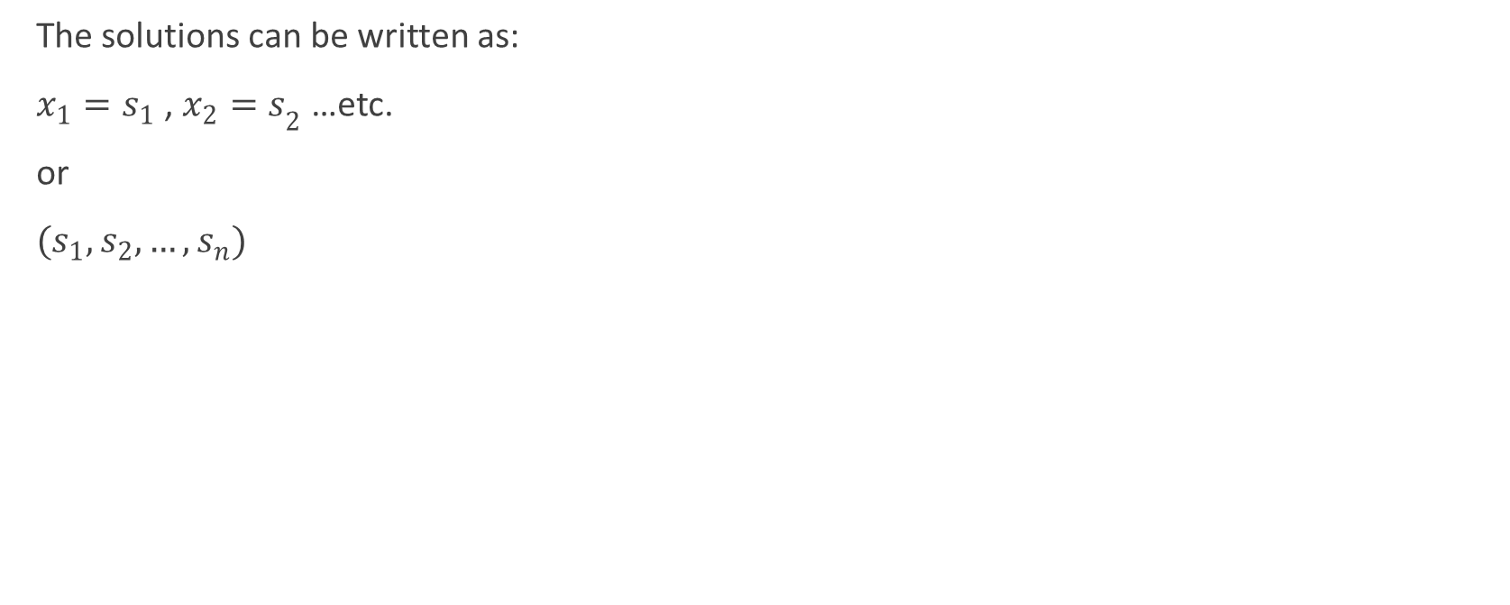
The solutions can be written as:
$x_{1}=s_{1}$ , ${x_{2}=s}_{2}$ …etc.
or
$(s_{1}, s_{2}, …, s_{n})$

Slide 10
Types of Solutions for systems of linear equations with 2 variables
A solution to a system of equations is an ordered pair that satisfy all the equations in the system.
A system of linear equations can have:
1. Exactly one solution
2. No solutions
3. Infinitely many solutions

Slide 11
Graphic representation of solutions for Linear Systems of 2 equations
Consistent
Inconsistent
Dependent
One solution
Lines intersect
No solution
Lines are parallel
Infinite number of solutions
Coincide-Same line

Slide 12
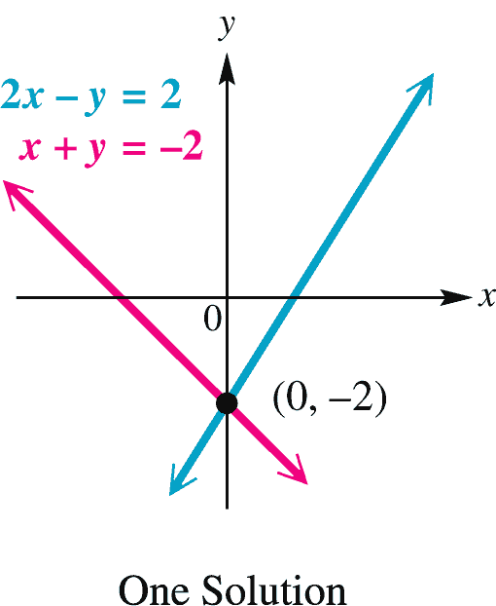
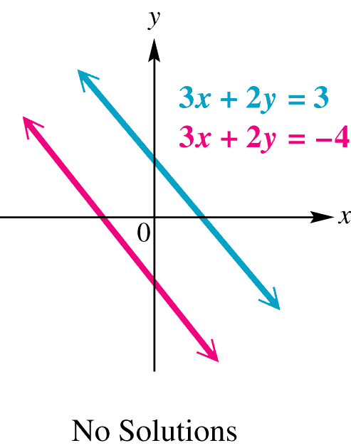
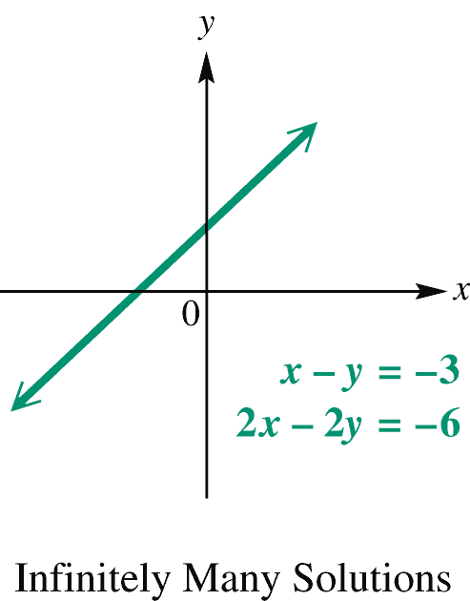
Linear System in Two Variables - Examples
Three possible solutions to a linear system in two variables:
One solution: coordinates of a point
No solutions: inconsistent case
Infinitely many solutions: dependent case

Slide 13
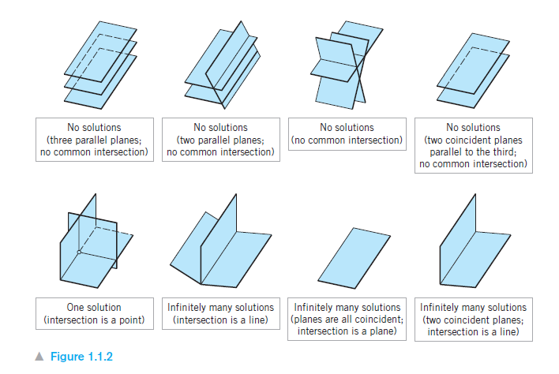
Graphic representation for types of solutions of Linear Systems in Three Variables

Slide 14
For systems with n variables…
It can be proved that any linear system (of any number of variables) has zero, one, or infinitely many solutions. There is no other possibility.

Slide 15
Augmented Matrix
We can write a system of linear equations as a matrix by writing only the coefficients and constants that appear in the equations.
This is called the augmented matrix of the system.

Slide 16
Augmented Matrix
Notice that a missing variable in an equation corresponds to a 0 entry in the augmented matrix.
Linear System | Augmented Matrix

Slide 17
Example—Finding Augmented Matrix of Linear System
Write the augmented matrix of the system of equations.

Slide 18
Elementary Row Operations
Interchange two rows.
Multiply/divide a row by a nonzero constant.
Add/subtract 2 rows.
Note that performing any of these operations on the augmented matrix of a system does not change its solution.

Slide 19
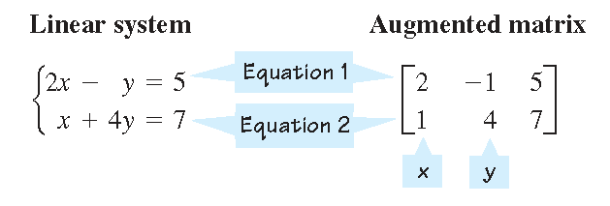
Example: Solving a system of 2 linear equations using the augmented matrix and row operations
This matrix is called the augmented matrix of the system.
The augmented matrix contains the same information as the system, but in a simpler form.
The operations we learned for solving systems of equations can now be performed on the augmented matrix.

Slide 21
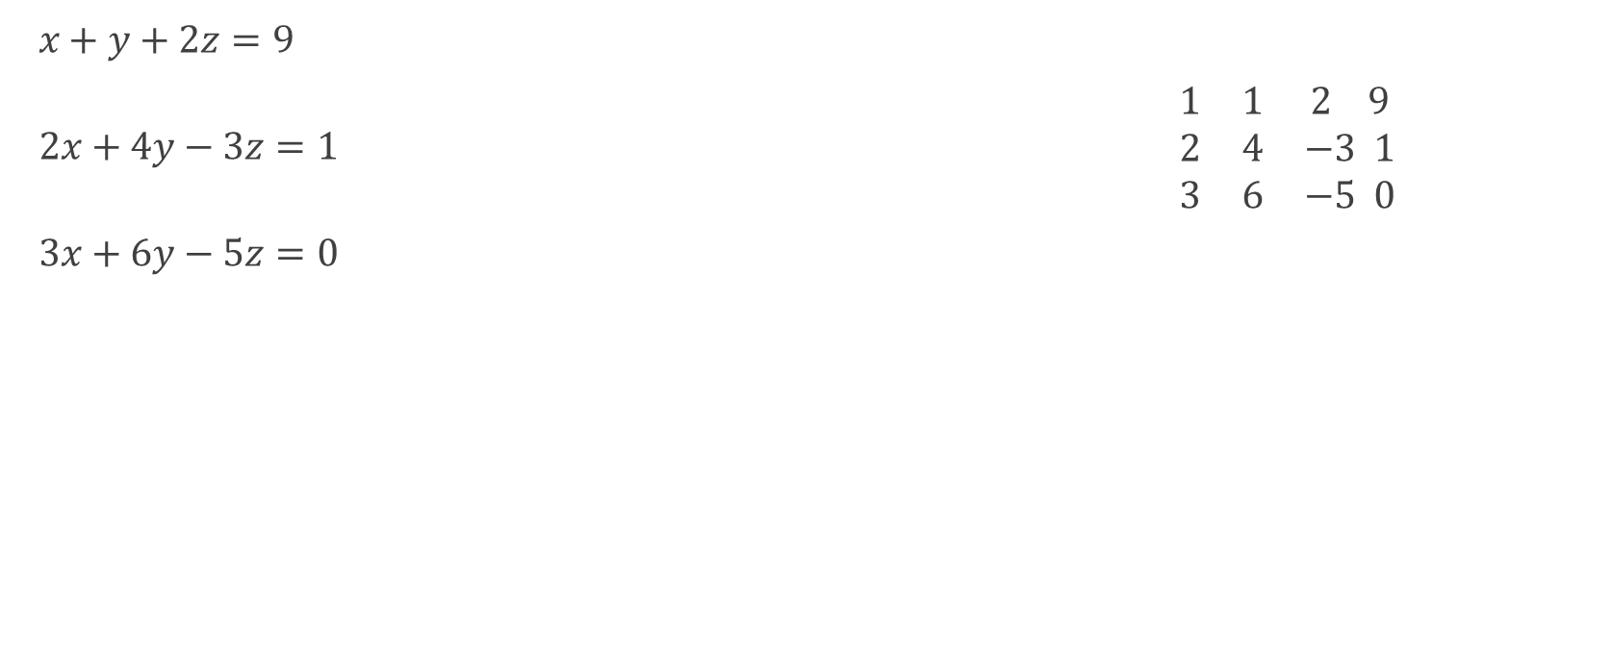
Practice row operations to solve the following system
$x+y+2z=9$
$2x+4y−3z=1$ $\begin{matrix}1 & 1 & 2 9 \\ 2 & 4 & −3 1 \\ 3 & 6 & −5 0\end{matrix}$
$3x+6y−5z=0$

